Slide 1
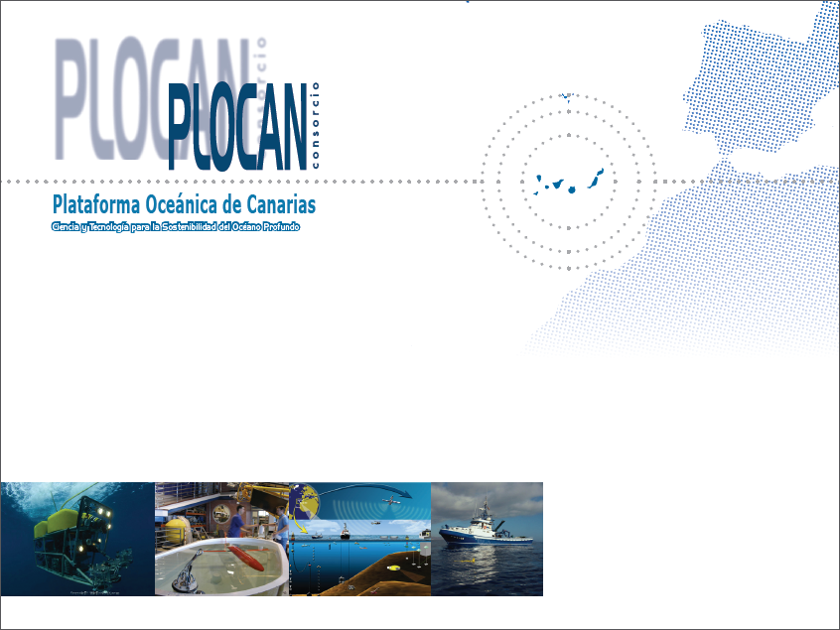
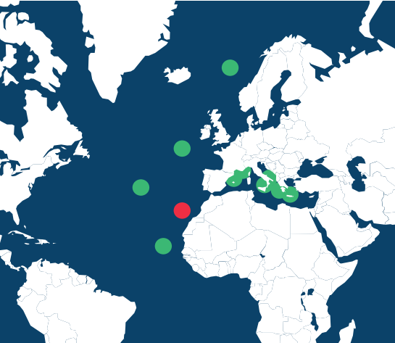
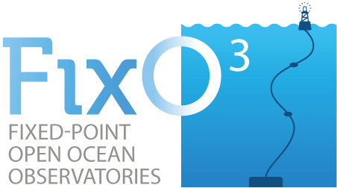
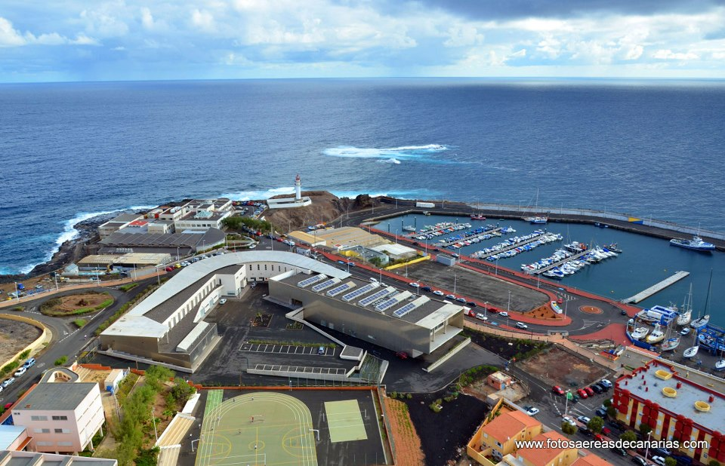
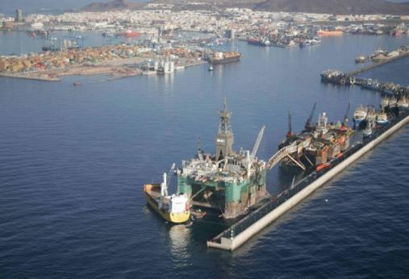
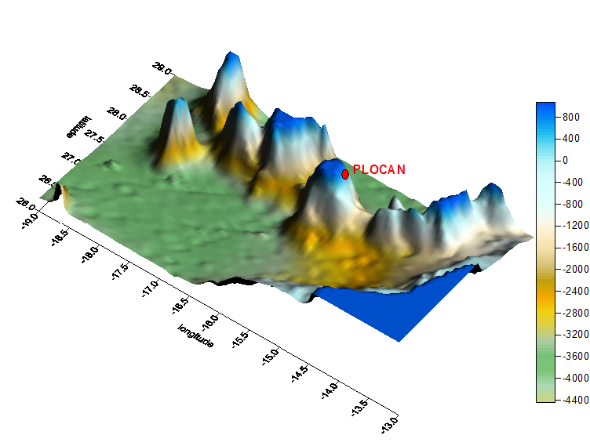
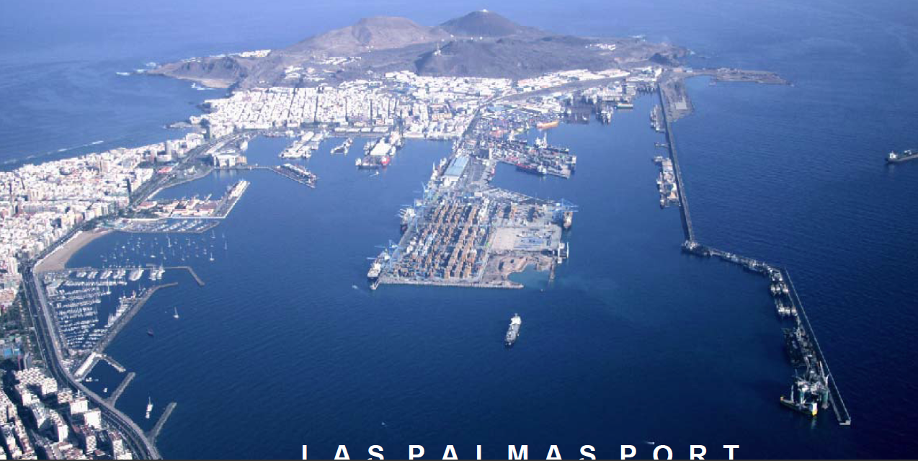
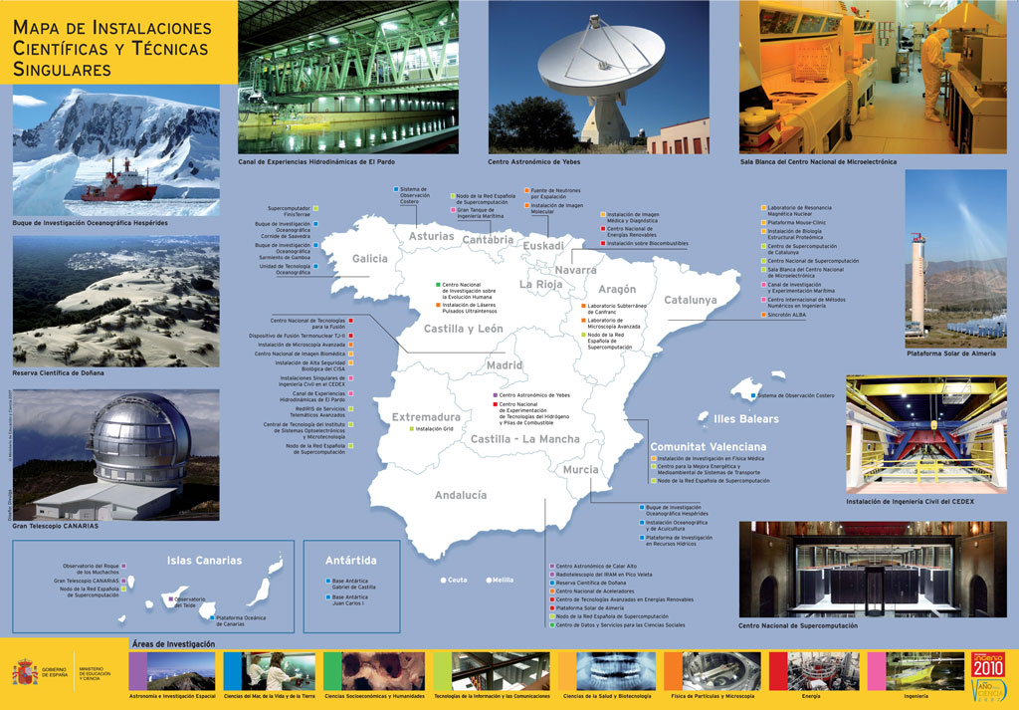
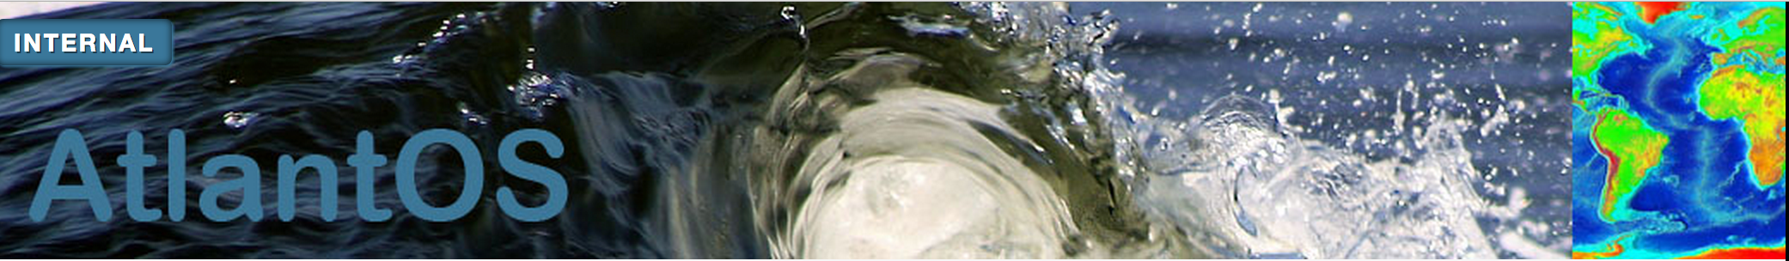
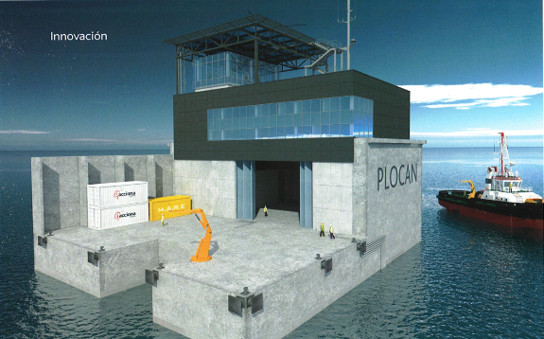
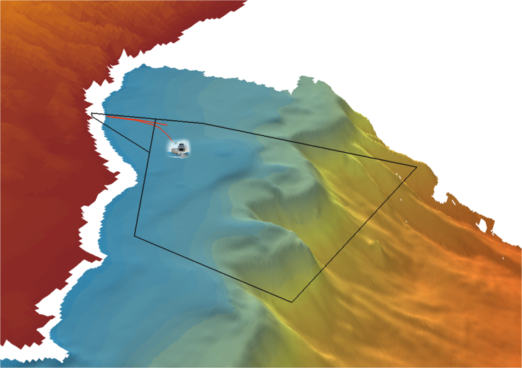
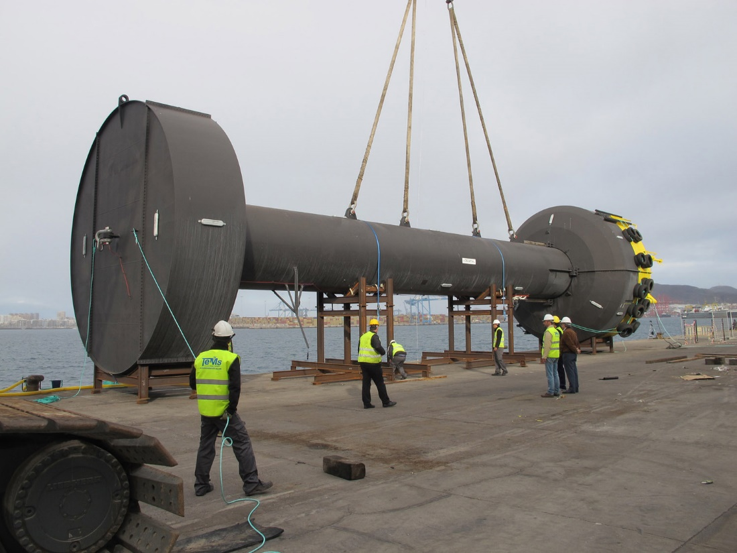
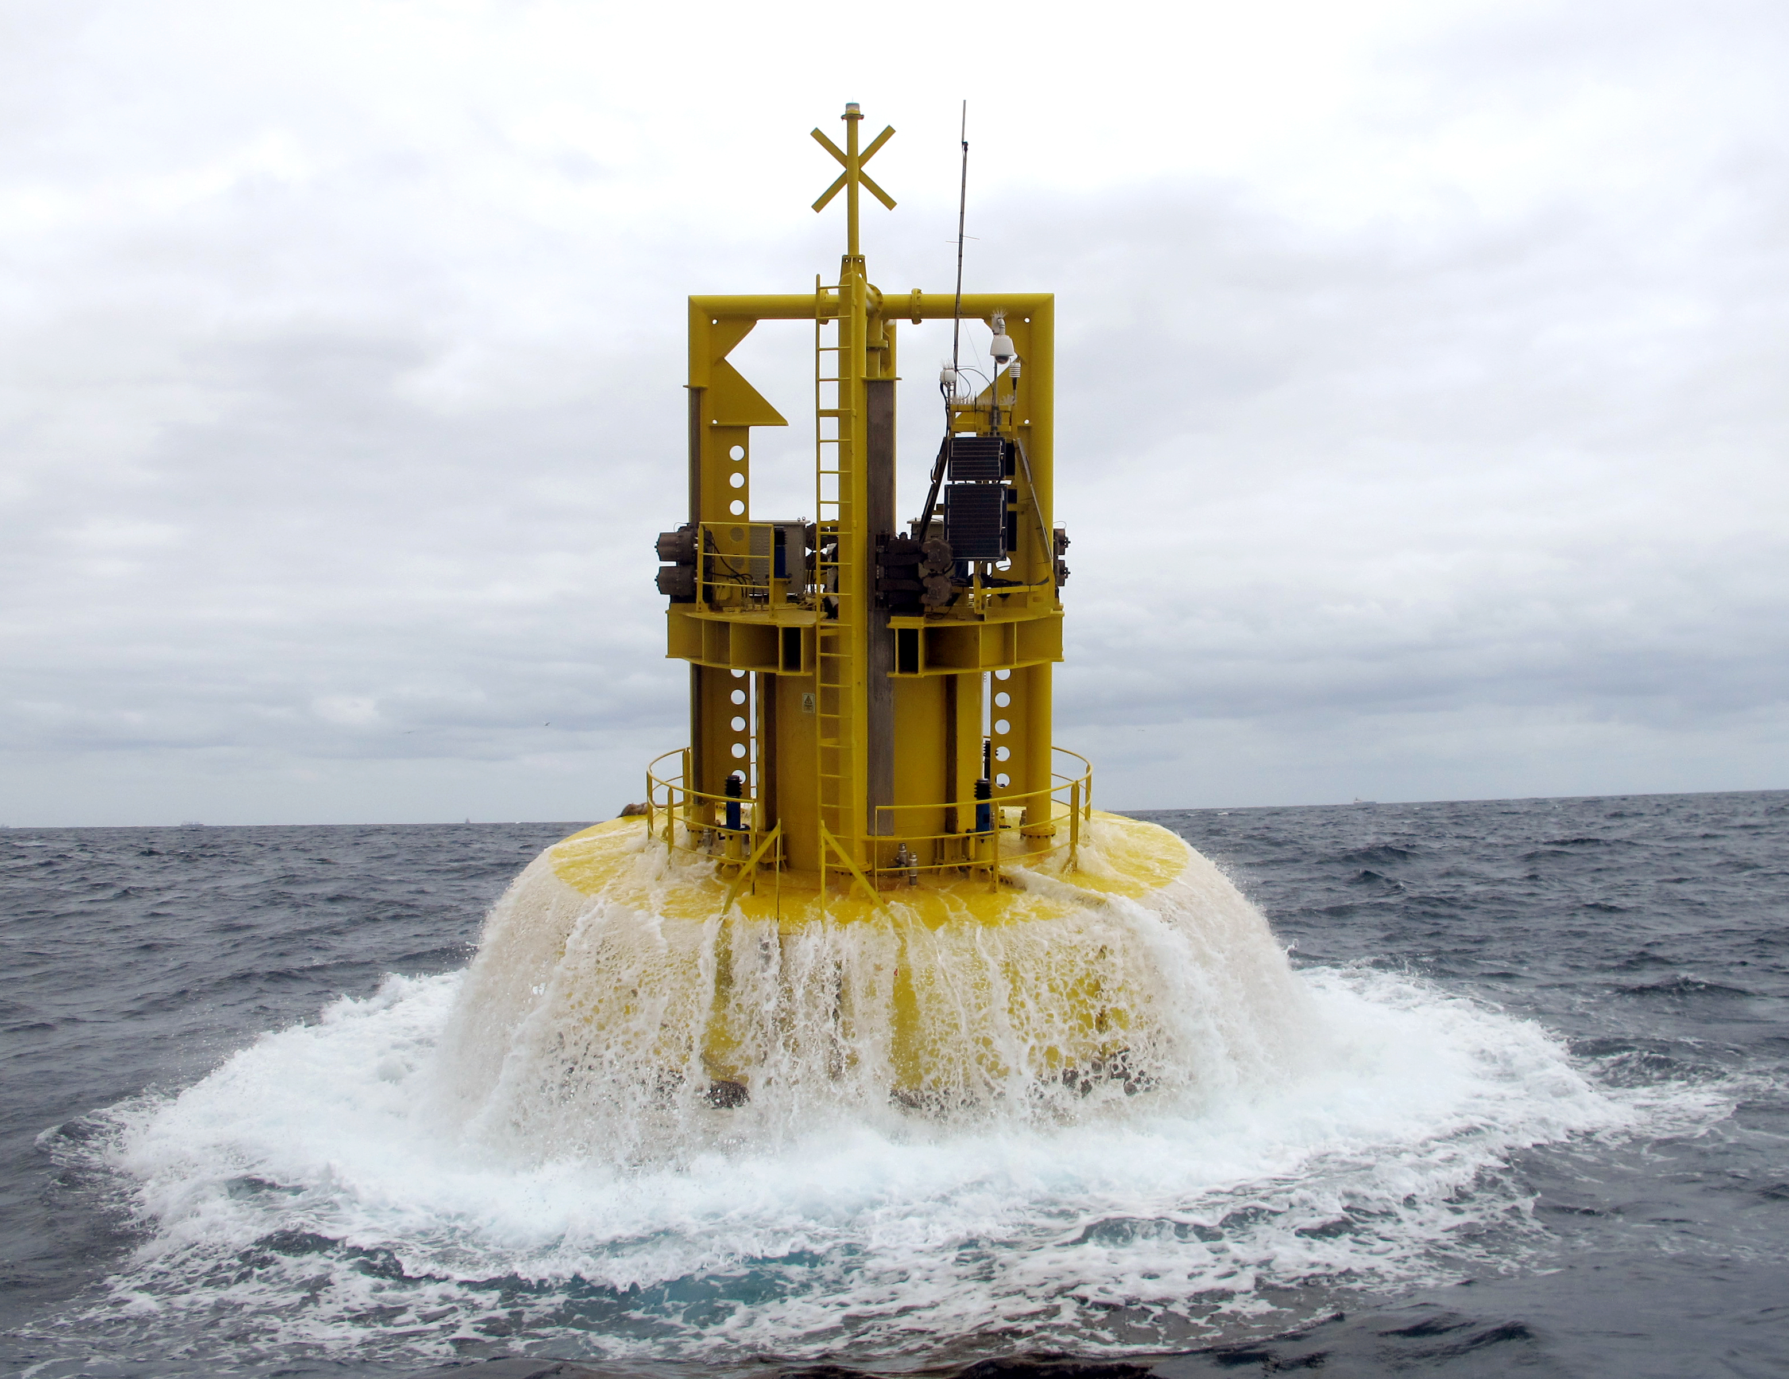


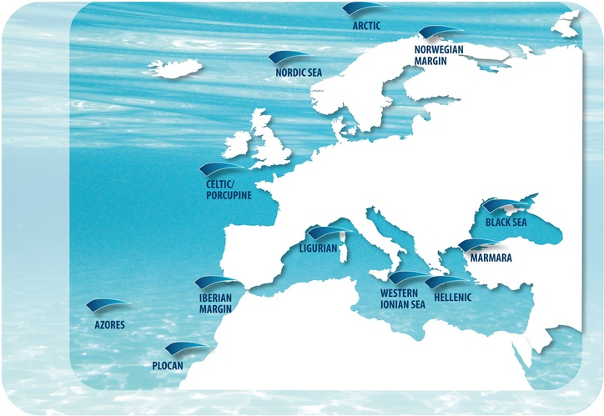
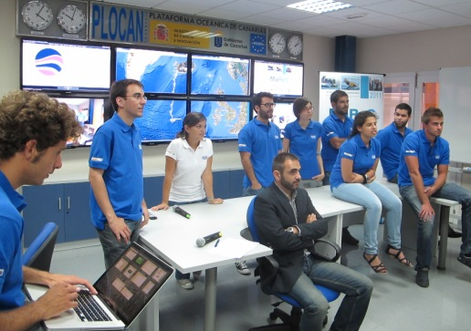
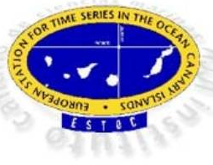
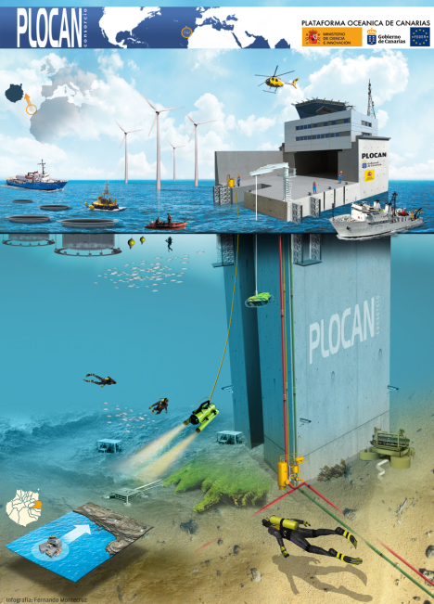
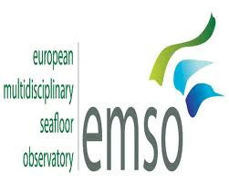
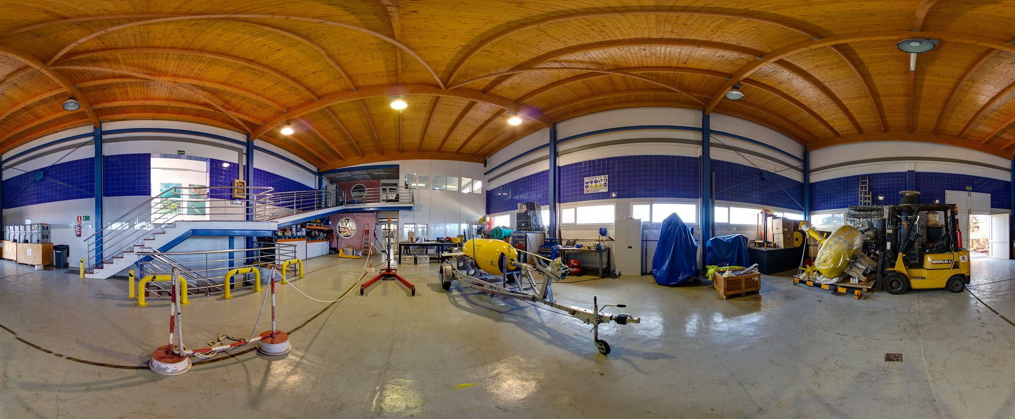
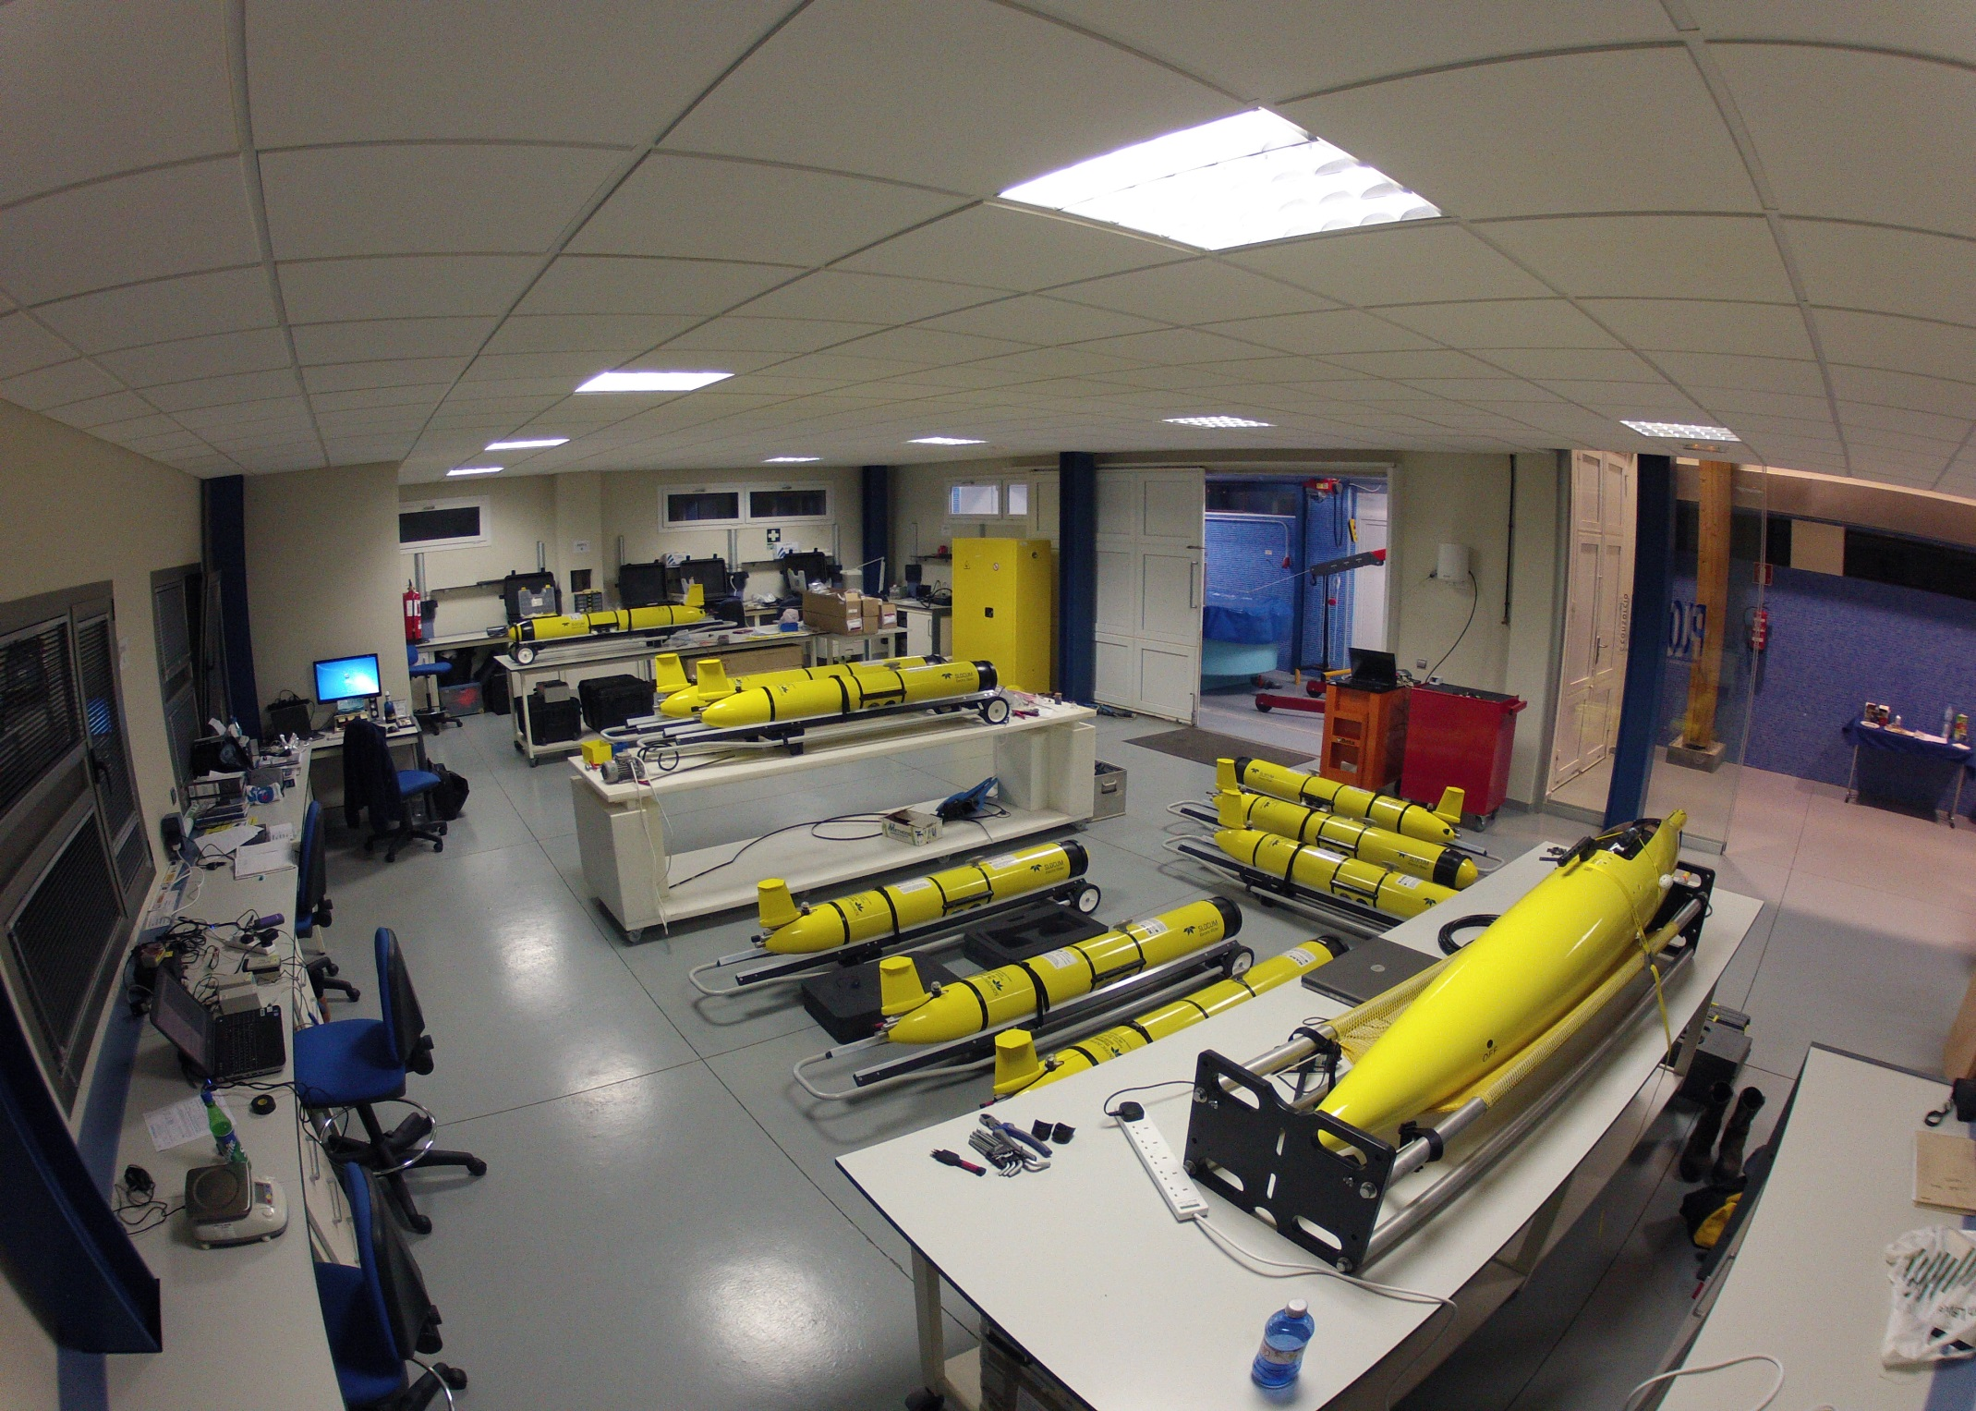
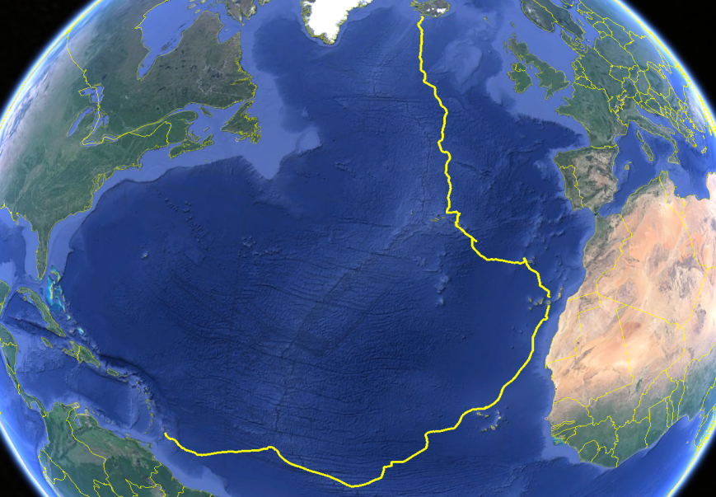
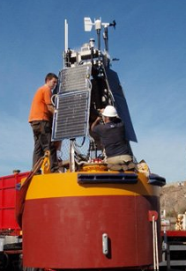

A multipurpose scientific infrastructure for the Central Atlantic
José Joaquín Hernández Brito - Manager

Slide 2
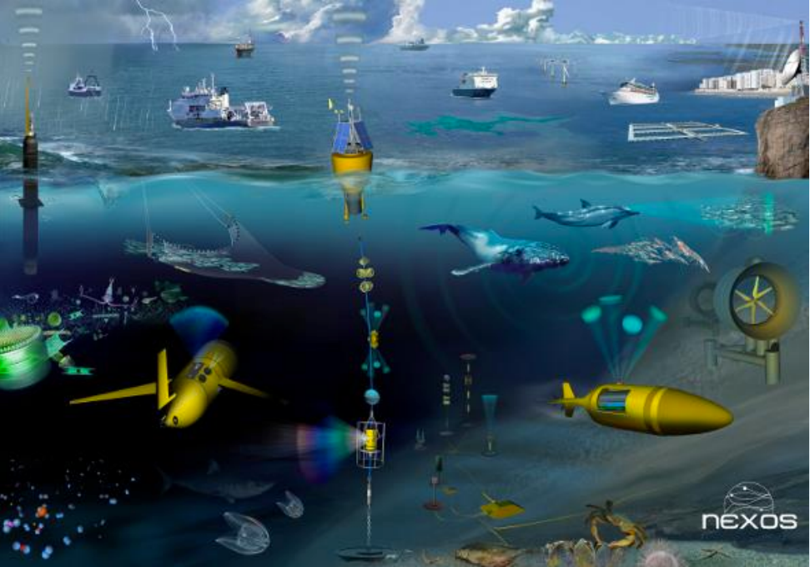
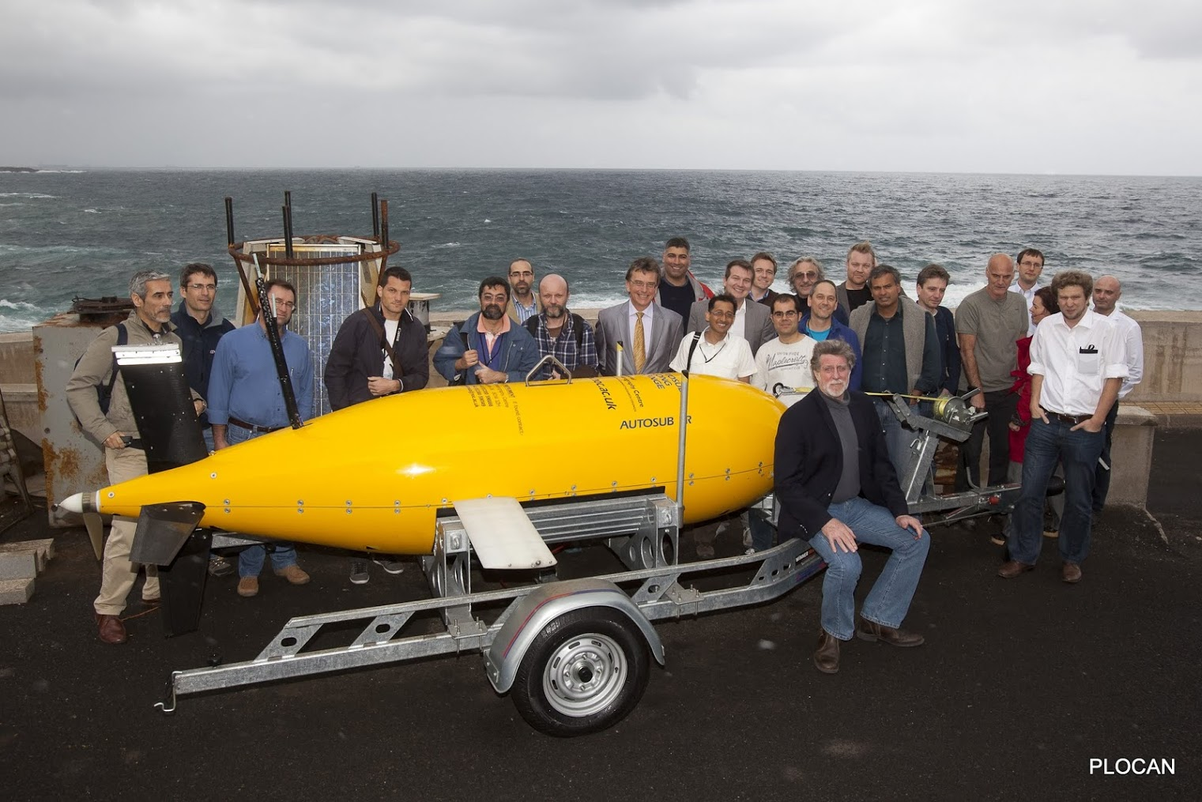
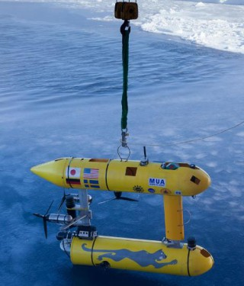
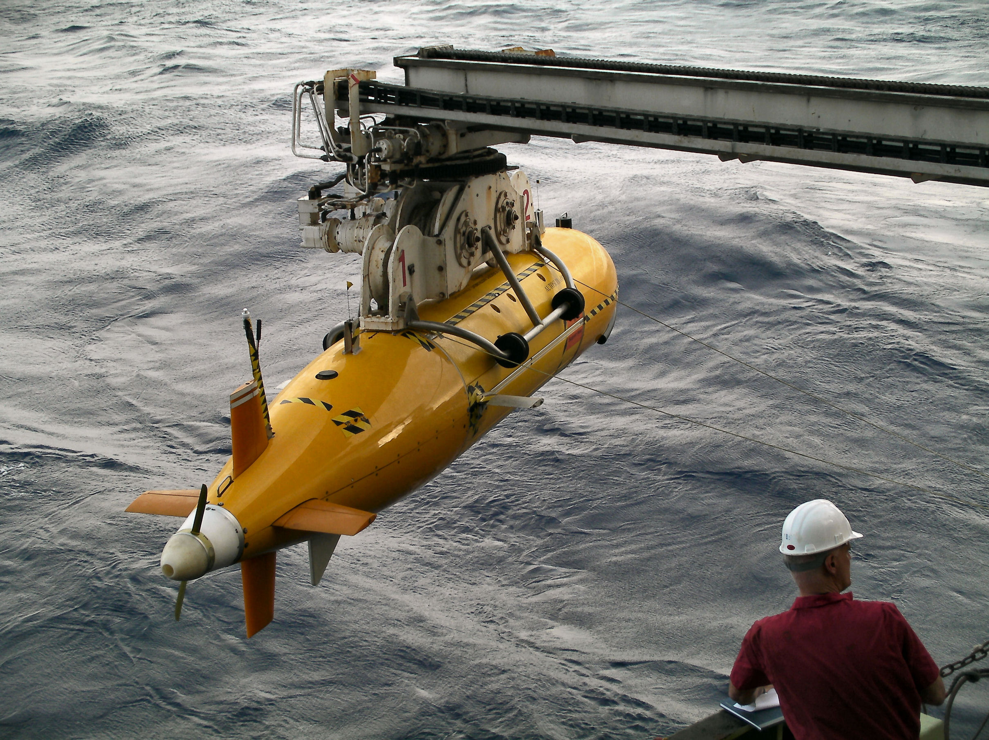
Relevant Priorities
Business model: who pays for what? Driven by science/industry/gov/citizens? Strategy for deep sea exploration, harnessing new resources, defense, exploration of new horizons, deep sea challenger, data users, applications, e.g. Integrated Atlantic Ocean Observing System (IAOOS).
Innovative sensor technology: new sensors, instruments and technologies needed to more completely monitor oceans, multiple sensor technologies, more functional, higher resolution, environmentally friendly.
Cost efficient platforms: value for purpose, expanding capacities of autonomous and robotic platforms, cheaper deep sea drones, shared/multi-use of common infrastructure, satellites, drifters, animals, integration of sensors at VOS...

Slide 3

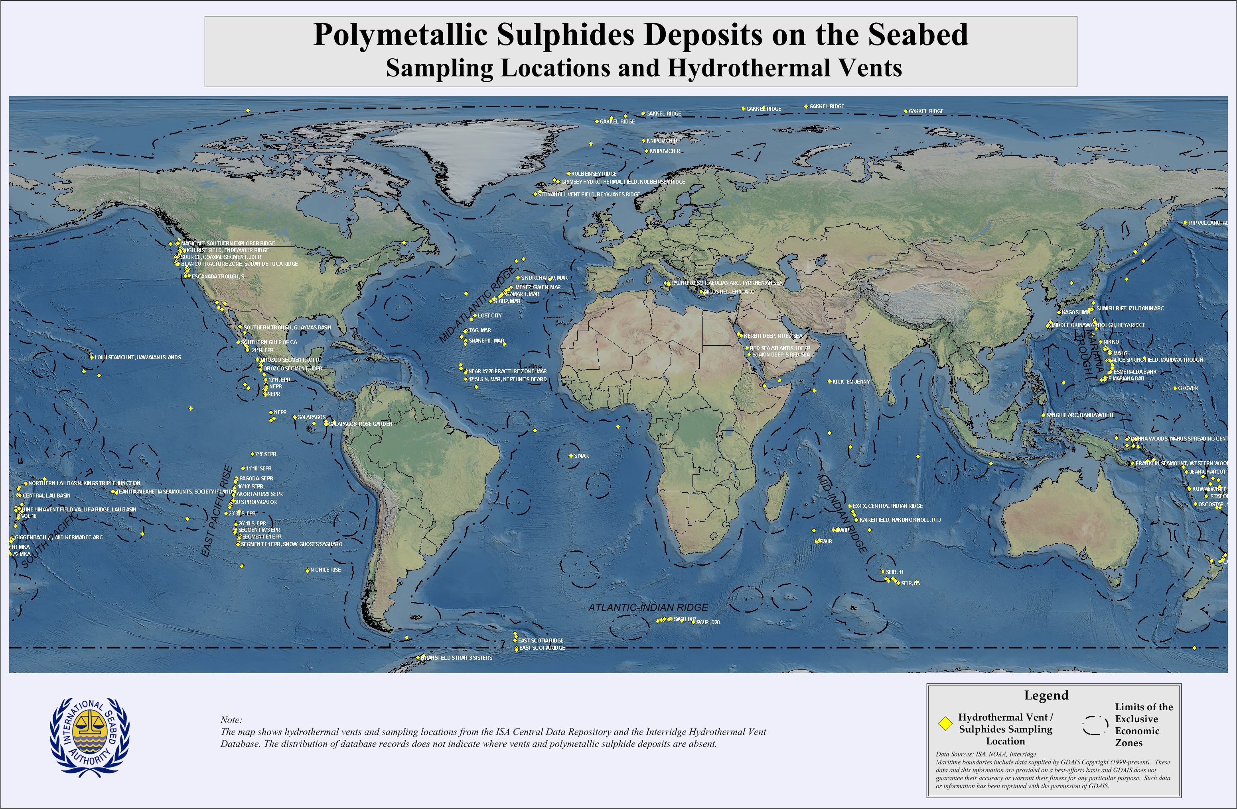
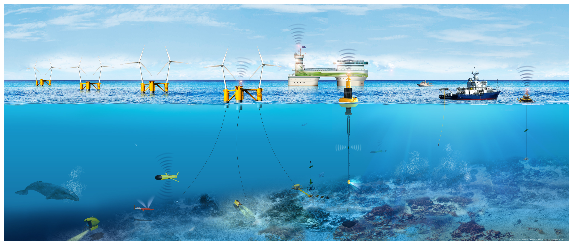
Implementation measures
Innovative fundraising.-Citizen-driven, crowd-funding, inspire the people. Life-support ecosystem services. A new age of exploration, citizens observatories.
Research infrastructure. Large research distributed infrastructure; coordination and clustering of services and resources, observations, data, standards, interoperability. Proposed infrastructure must have a business plan, and risk management strategy, that identifies opportunities for long term operational support (*). Infrastructure fund (€300bn)?.
PPP for sub-sea technologies.-Technology driven. From R&D to R&I, new robotic concepts including smart fleets of vehicles working together, new platforms like gliders, rapid evolution, engage more agents, SME, more competition and field for evolution. Synergies with other sectors. What applets, what business models from space technology could be reused for deep sea?-
(*) A Canadian Contribution to an Integrated Atlantic Ocean Observing System (IAOOS). D. Wallace et al.

